Slide 1
Discovering Braille

Slide 2
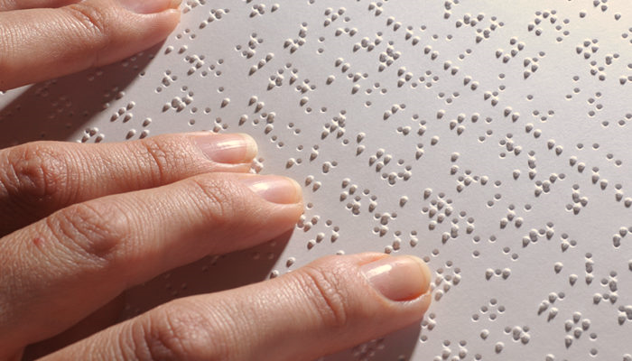
About Braille
Braille is the system of reading and writing used by people who are blind. Readers use their fingertips to feel raised dots that represent the letters of the alphabet.

Slide 3
How does braille work?
Braille letters are formed by a combination of raised dots within a braille cell.
Each braille cell is made up of 6 dots.
The dots are often referred to by their cell number.
The 6 dots in a cell can be arranged into 64 different combinations.

Slide 4
The Braille Alphabet A-J
A braille letter is formed by the raised dots within a cell.
For letter A, only dot 1 is raised. For letter B, dots 1 and 2 are raised. For letter C, dots 1 and 4 are raised, and so on.
The letters A-J use only the top 4 cells.

Slide 5
The Braille Alphabet K-T
The letters K-T add dot 3 to each of the previous letters.
For example, the letter K is the same as letter A, but with dot 3 added. L is the same as B with dot 3 added, and so on.

Slide 6
The Braille Alphabet U-Z
The last set of letters continues the pattern by adding a dot 6 to the second set of letters.
Note: At the time Louis Braille invented braille, there was no W in the French language. The braille letter W was later created by dots 2, 4, 5, 6.

Slide 7
Braille Numbers
Braille numbers 1-10 are the same as letters A-J, except they have the number sign before them.
The number sign is dots 3,4,5,and 6.

Slide 8
Types of Braille
Braille used for reading and writing is called Literary Braille.
There is a different braille code used for mathematics called Nemeth Braille and another braille code used for musical notation.
Each language has its own braille code to account for its unique letters. Some examples are Ñ in Spanish, Ü in German, and Ç in French.
The current braille code used in America is called Unified English Braille (UEB). It incorporates symbols used in literary, math, science, and computer fields, like the @ used in email addresses.

Slide 9
Contracted and Uncontracted Braille
Braille takes up a lot more space than print.
Braille that is a letter-by-letter translation is called uncontracted braille, or Grade 1 braille.
Most braille is contracted braille, or Grade 2 braille. It uses 180 contractions, or shortcuts, for the most common words and word parts.
Examples of contractions:
As is shortened to z Blind is shortened to bl
Could is shortened to cd Together is shortened to tgr
Yourself is shortened to yrf

Slide 10
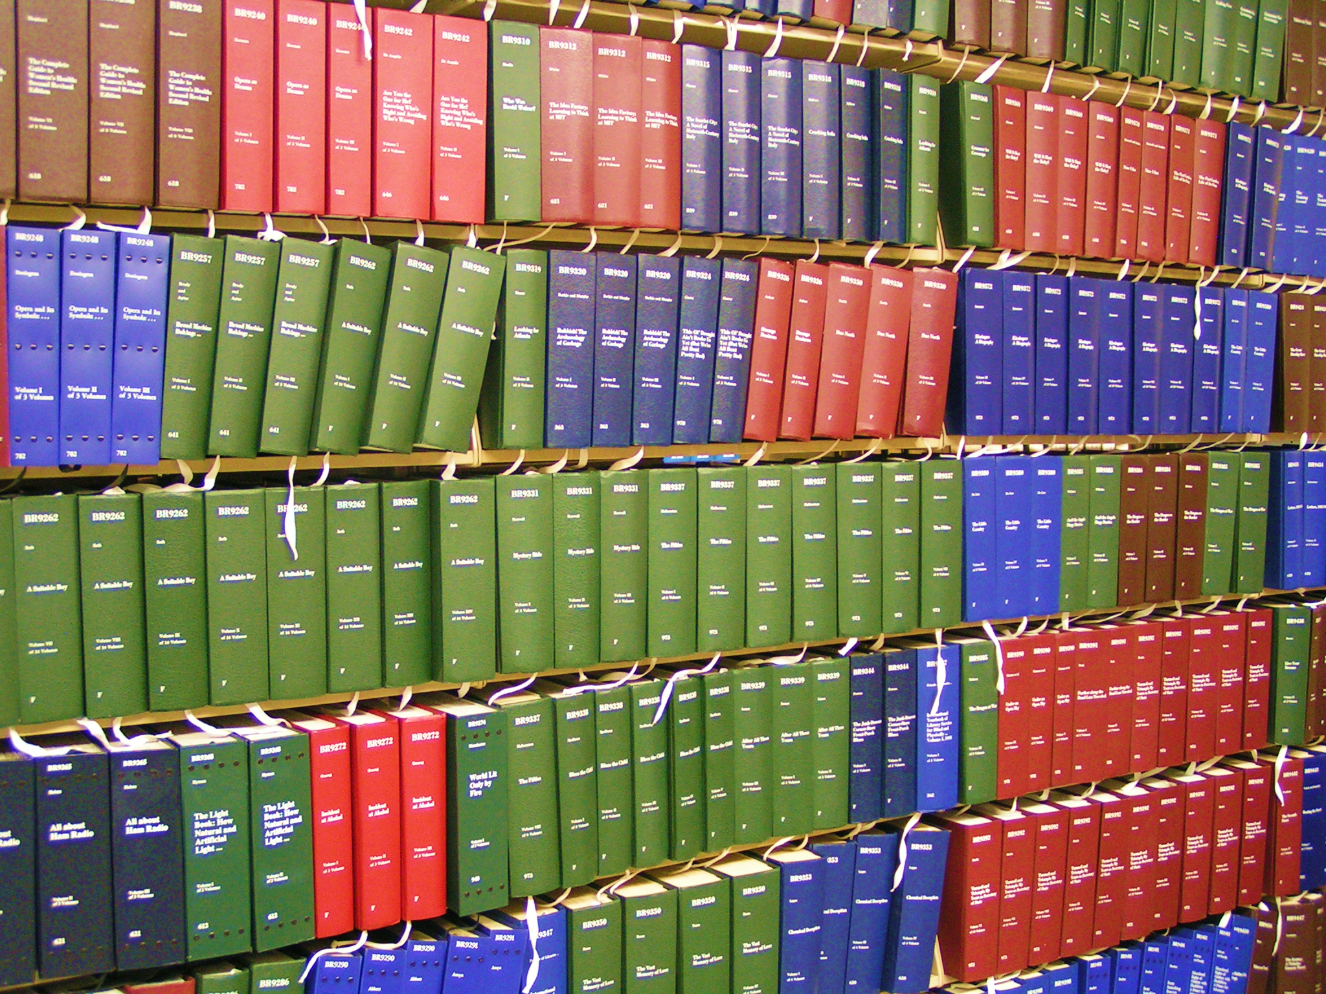
Braille Books (Available from the Kentucky Talking Book Library)
Braille books usually come in multiple parts, called volumes.
The average braille book for adults has 3 volumes.
Some books can be much larger. This one has 10 volumes.
The Bible has 24 braille volumes!

Slide 11
Is braille still necessary with audiobooks and computer screen readers?
Of course! There is no substitute for the ability to read, whether using print or braille.
Braille is essential for learning grammar, spelling, punctuation, and formatting.
Only a small number of all books published are available in audio.
Braille literacy is important for success in school, work, and daily life. Just think about how many times a day you read without realizing it!

Slide 12
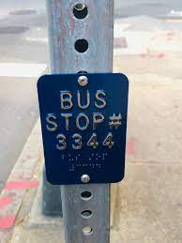
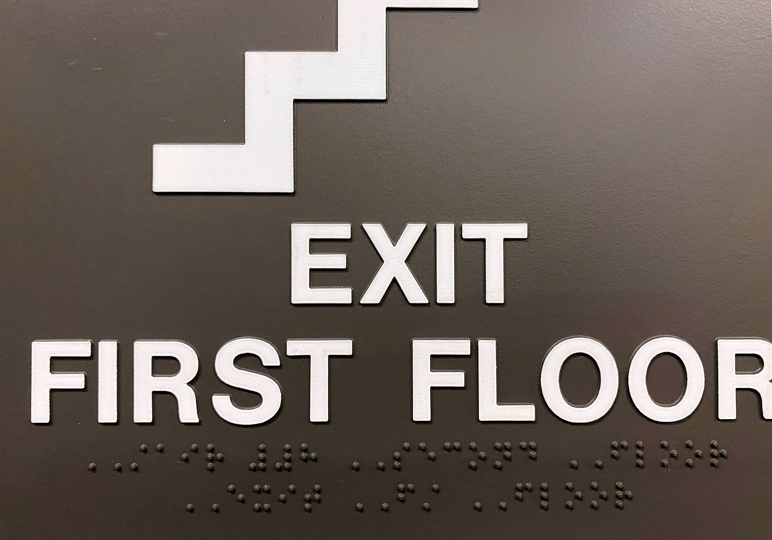
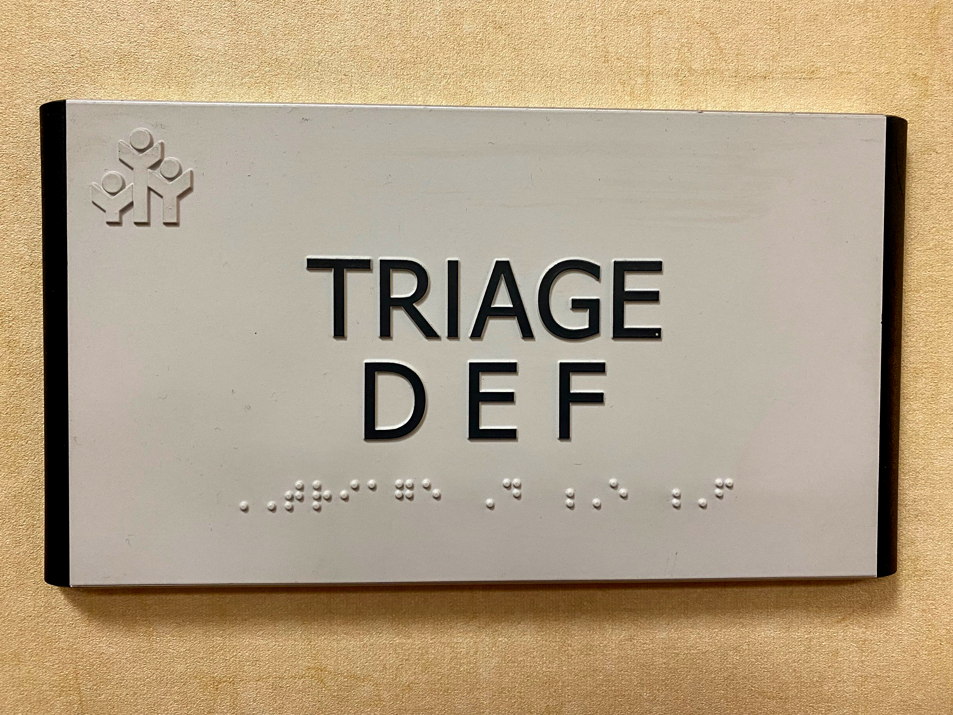
Many public places have braille signs.

Slide 13
Look for examples of braille wherever you go.

Slide 14
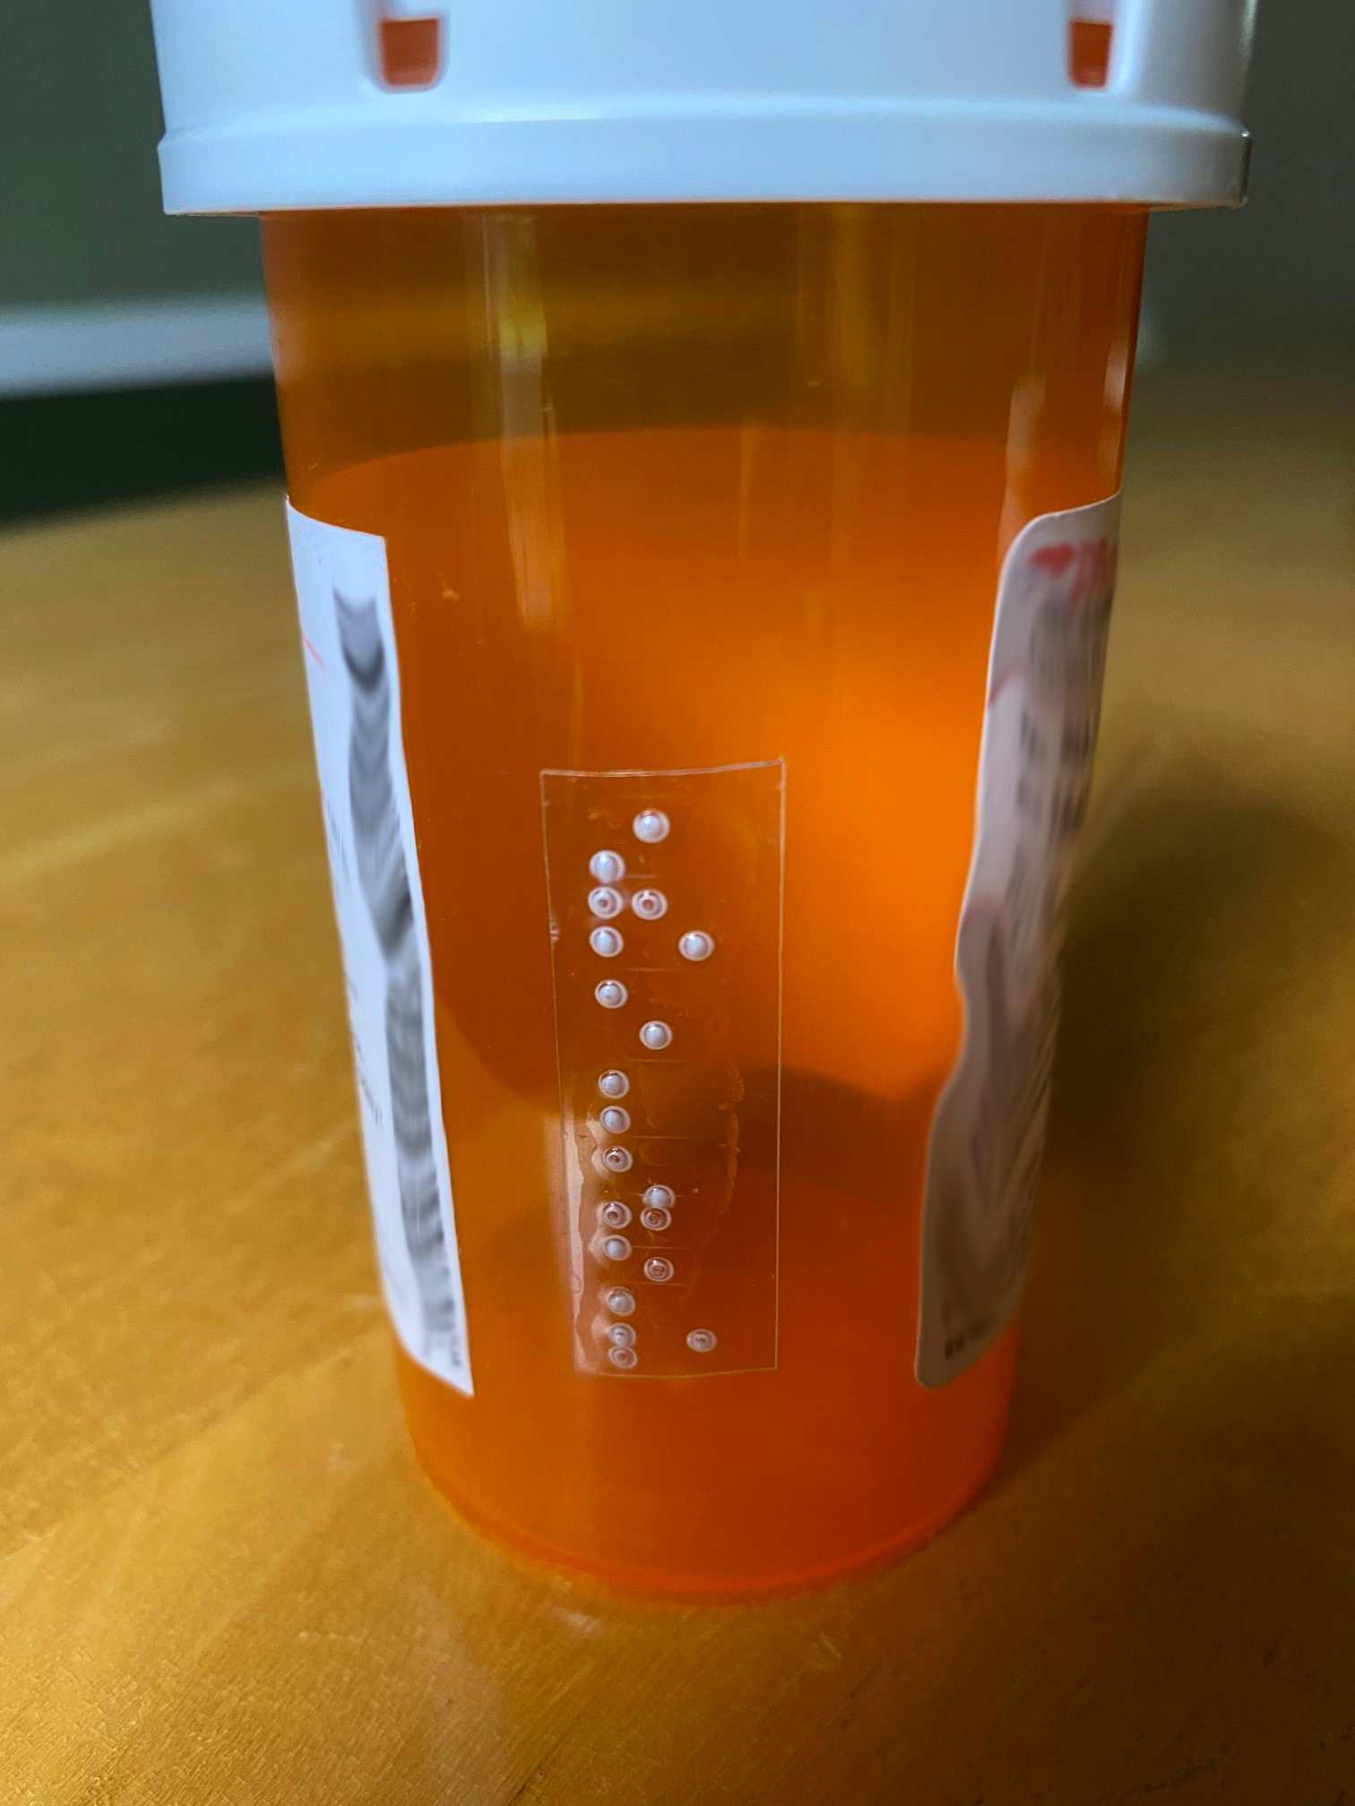
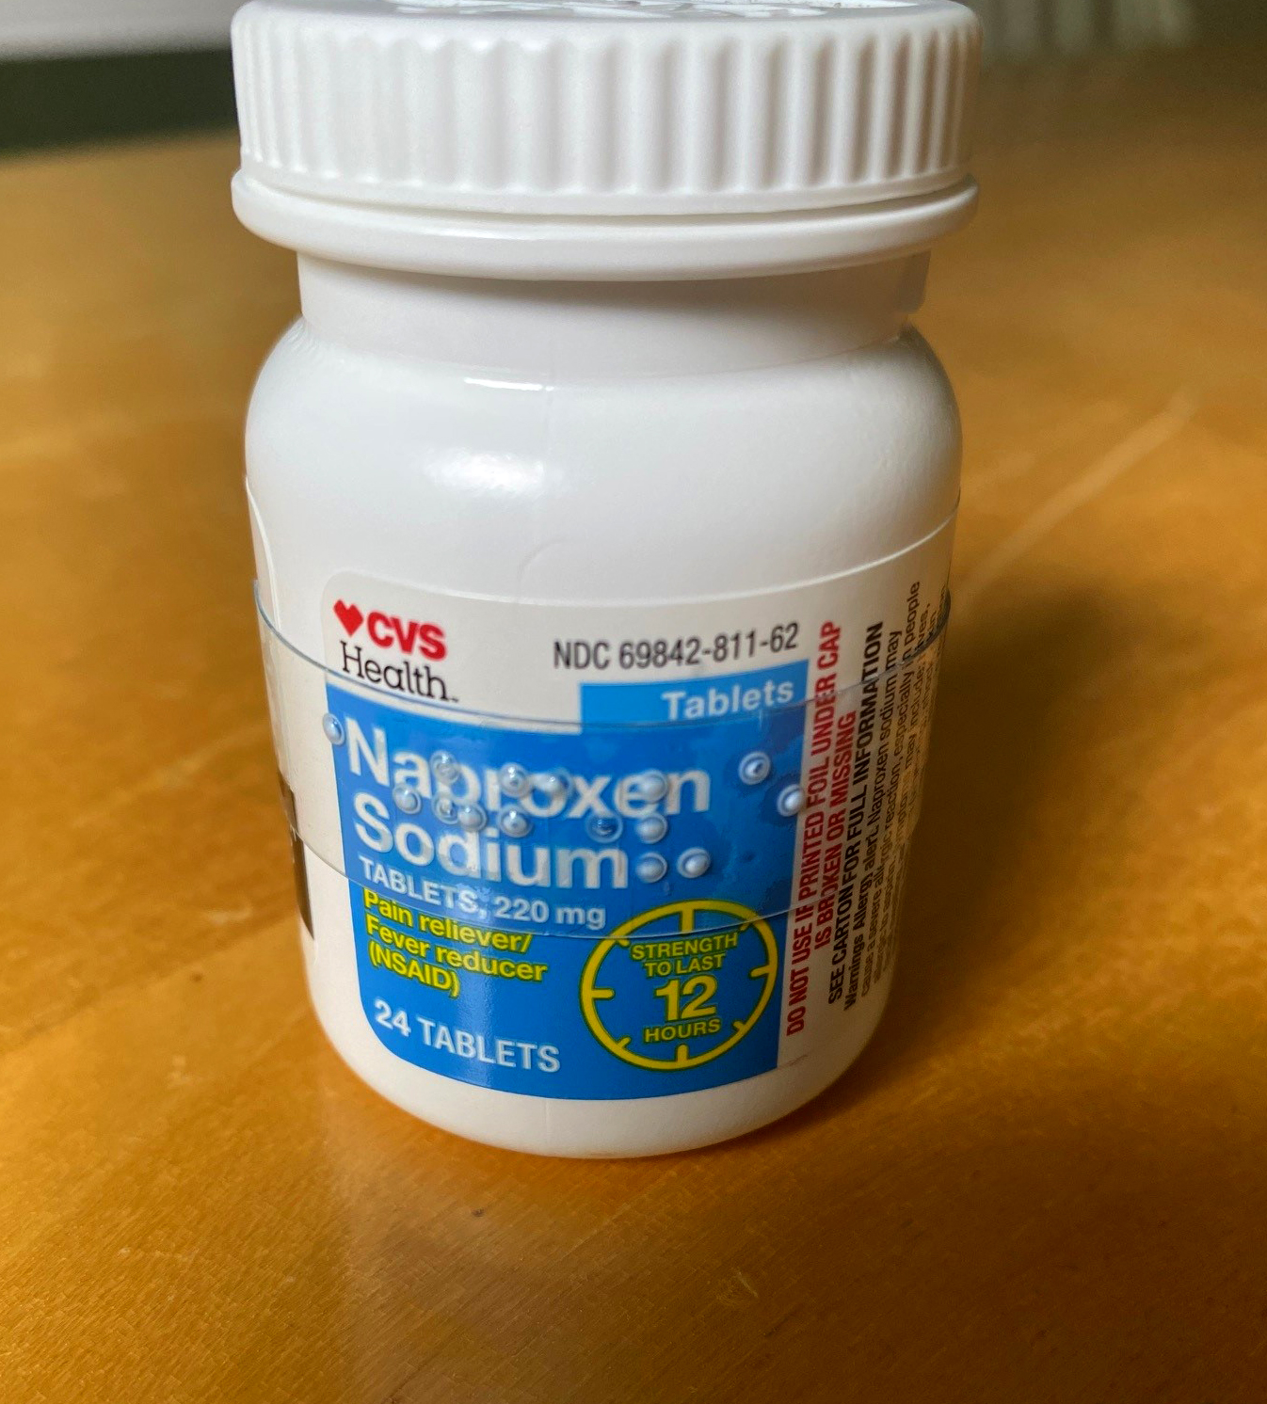
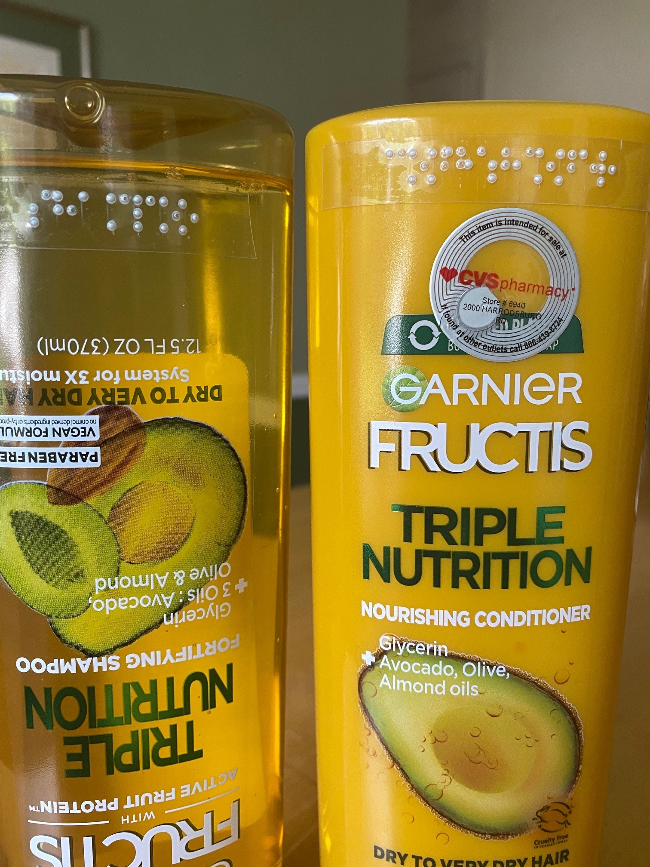
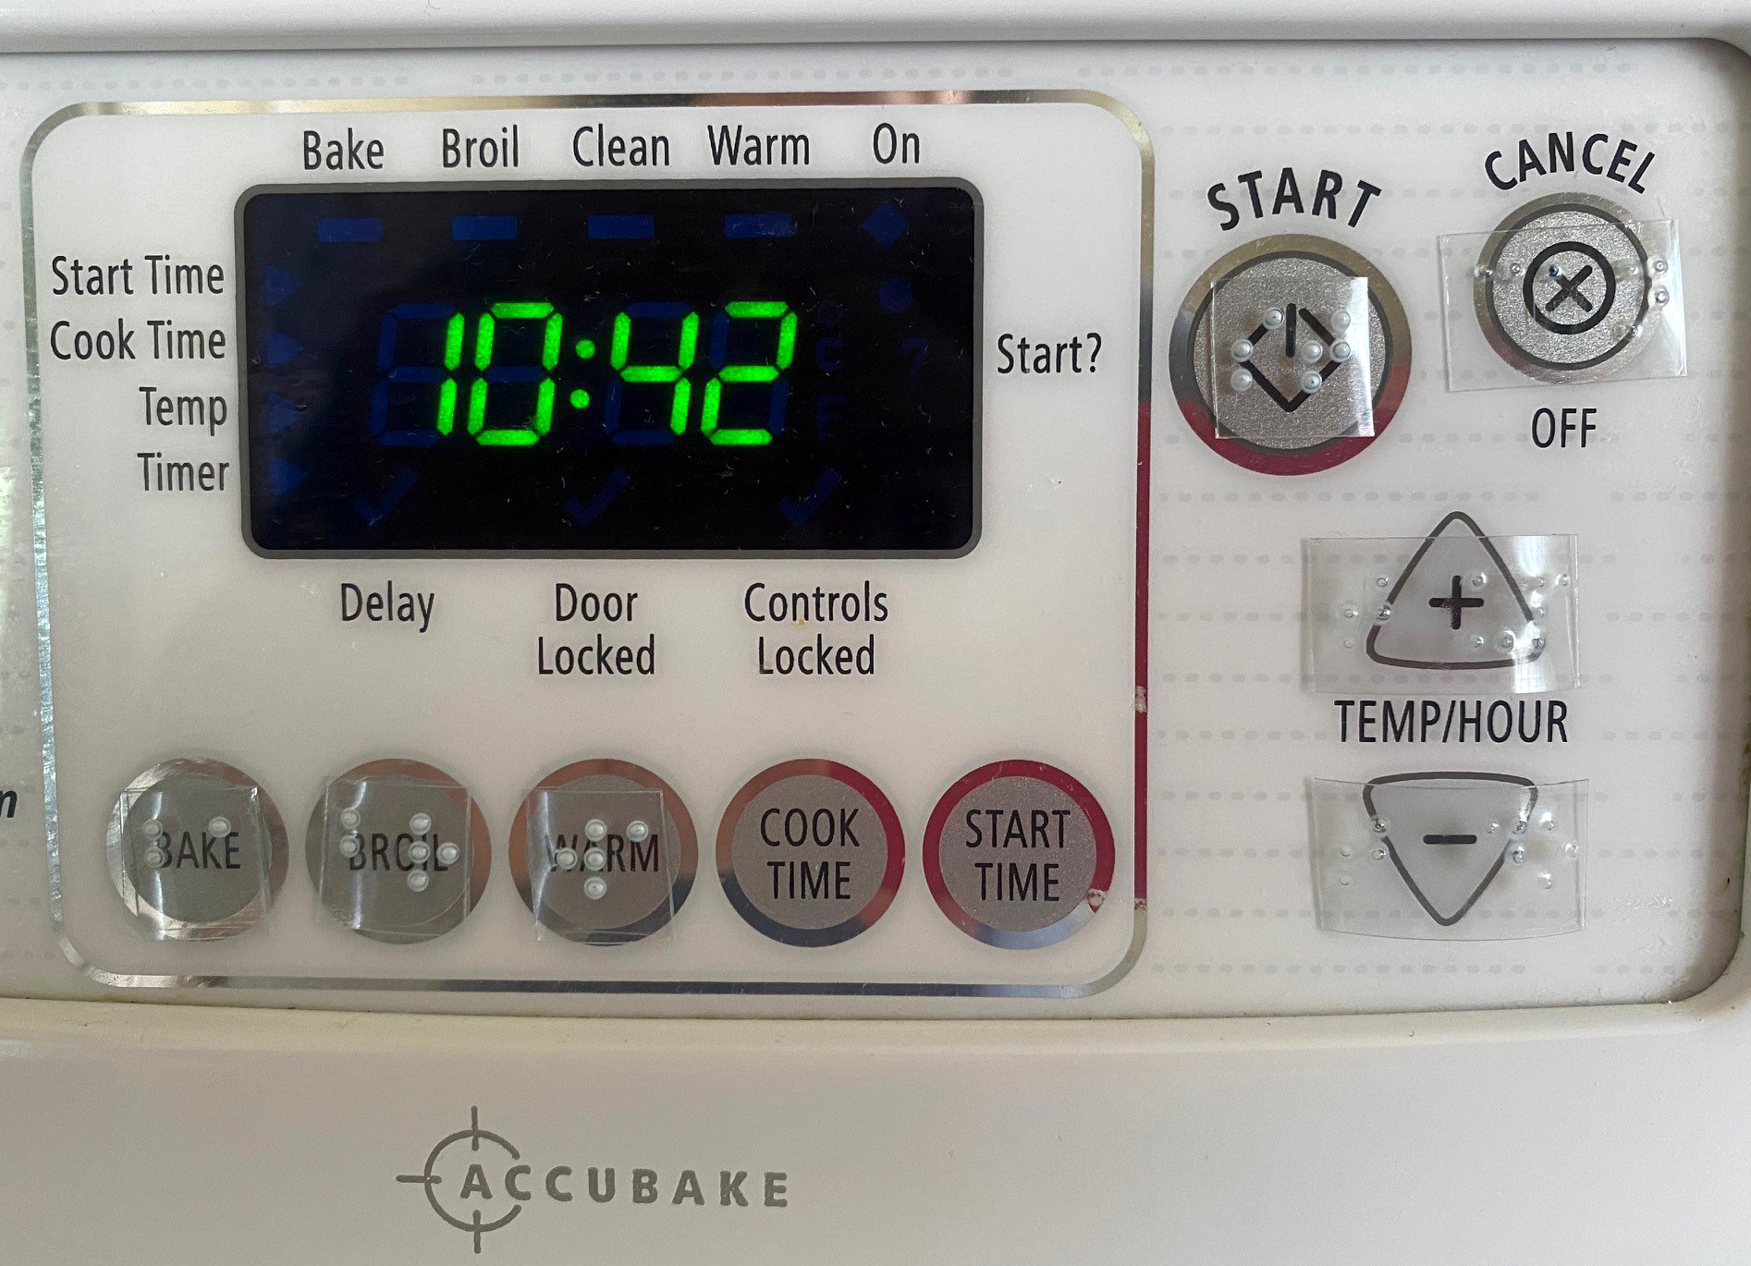
What about at home? A braille labeler can be very helpful.

Slide 15
Learning Braille
Students may learn braille from a Teacher of the Visually Impaired who works with their regular teacher.
Some students may attend a special school, like the Kentucky School for the Blind in Louisville.

Slide 16
Reading Braille Braille is read by moving one or more fingers along each line. Most readers use both hands—using the pointer finger of one hand to read a line, and their other hand to mark the place where the next line starts.

Slide 17
Writing Braille Braille can be written, or embossed, by hand using a slate and stylus. The sharp stylus pokes a dot onto the back of the paper. This means you must use a backwards braille alphabet so the words appear correctly on the front of the paper.

Slide 18
Typing Braille The Perkins Brailler is a typewriter that types braille. You must hit all the keys needed to make a braille letter at once, like playing a chord on the piano. For example, to type the letter G you must press keys 1,2, 4, and 5 (the G chord) at the same time.

Slide 19
Braille and Computers Technology allows braille translation software to convert computer text into a braille file (brf). A braille embosser is like a printer that “prints” embossed braille. A refreshable braille display has small metal pins that represent braille one line at a time.

Slide 20
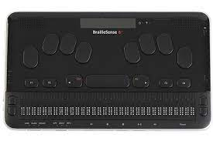
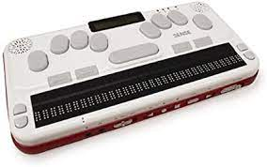
Portable Devices Many people use a braille notetaker. This is a small, portable refreshable braille device that can also perform many of the same functions of a computer. It allows users to read, write, and save electronic braille wherever they are.

Slide 21
For more information about braille, contact the Kentucky Talking Book Library at 800-372-2968 or ktbl.ky.gov
Meanwhile, have fun with some braille activities!

