Slide 1


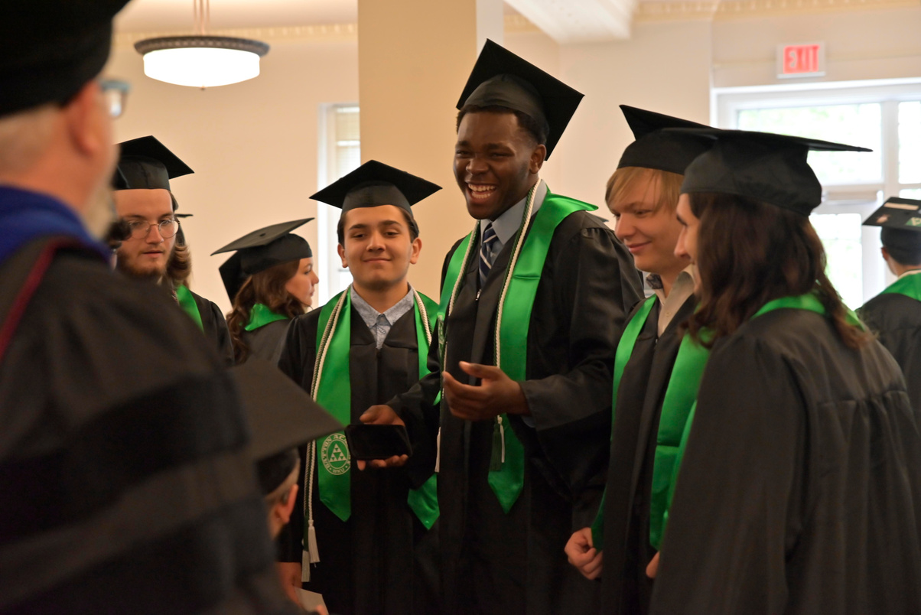
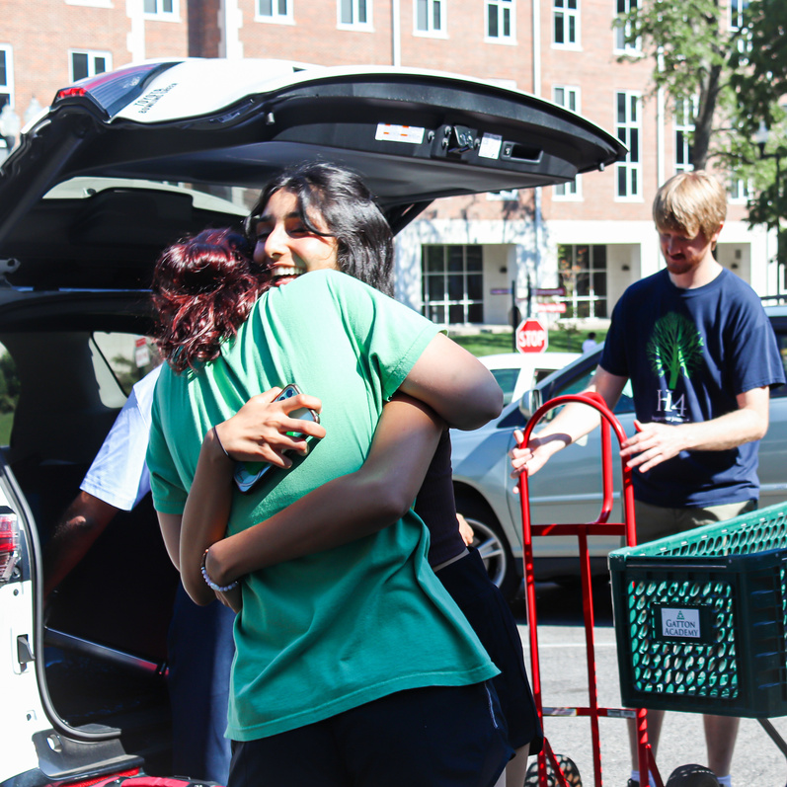
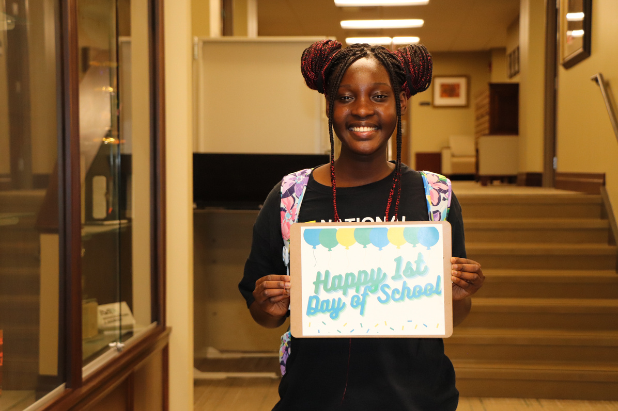
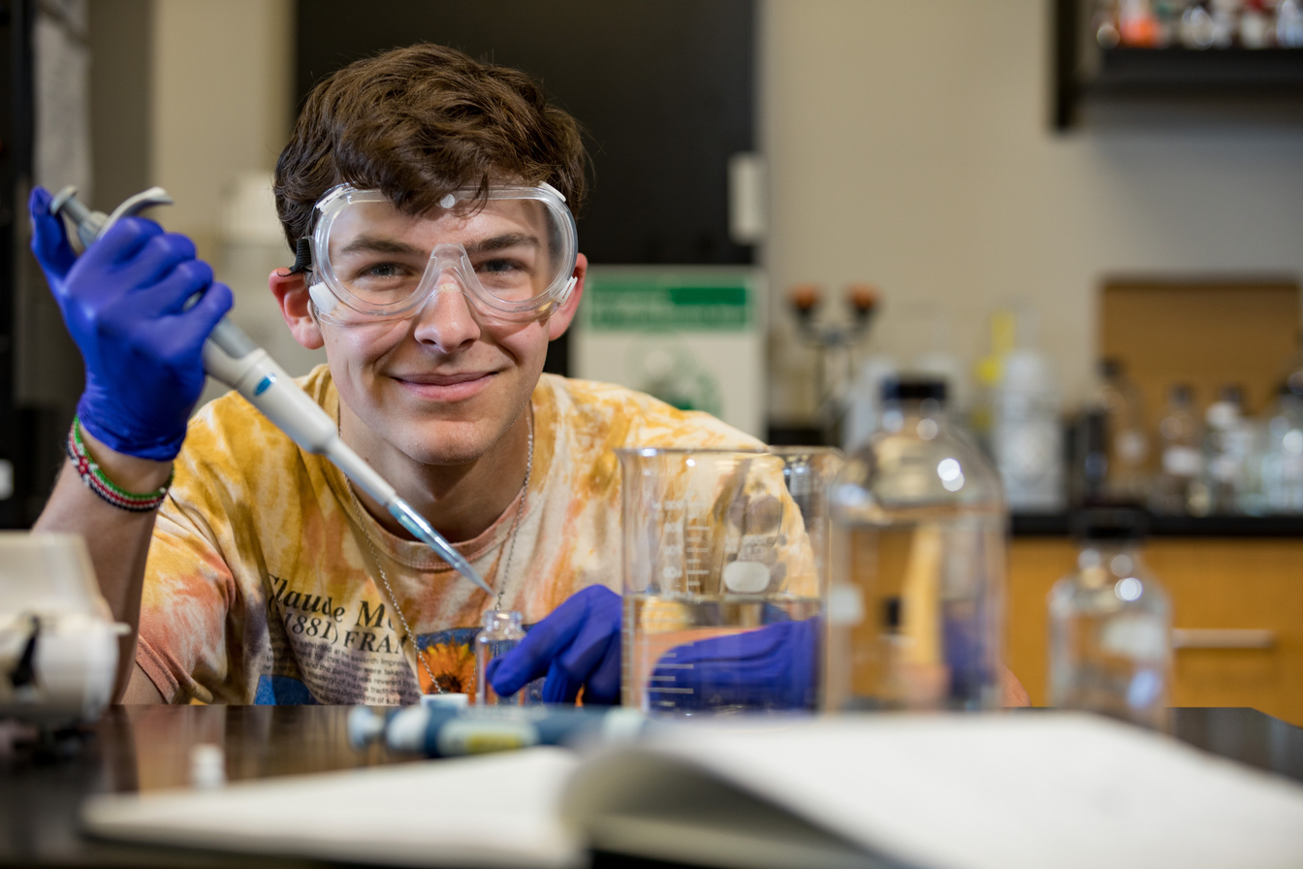
Kari Lynn Somers
kari.somers@wku.edu
Jodi Dosier
jodi.dosier@wku.edu
@GattonAcademy

Slide 2


WHO?
Residential
STEM program
for gifted and talented
juniors and seniors in
Kentucky at WKU for 60 hours college credit at little to no cost.

Slide 3
WHO?
Residential
STEM program
for gifted and talented
juniors and seniors in
Kentucky at WKU for 60 hours college credit at little to no cost.
WHAT?
Research
Languages
Student Life
Study Abroad
College Courses

Slide 4
WHO?
Residential
STEM program
for gifted and talented
juniors and seniors in
Kentucky at WKU for 60 hours college credit at little to no cost.
WHAT?
WHEN?
Research
Languages
Student Life
Study Abroad
College Courses
All school-year -
Live at Gatton with
190 other Kentucky high
school students interested
in exploring new things.

Slide 5
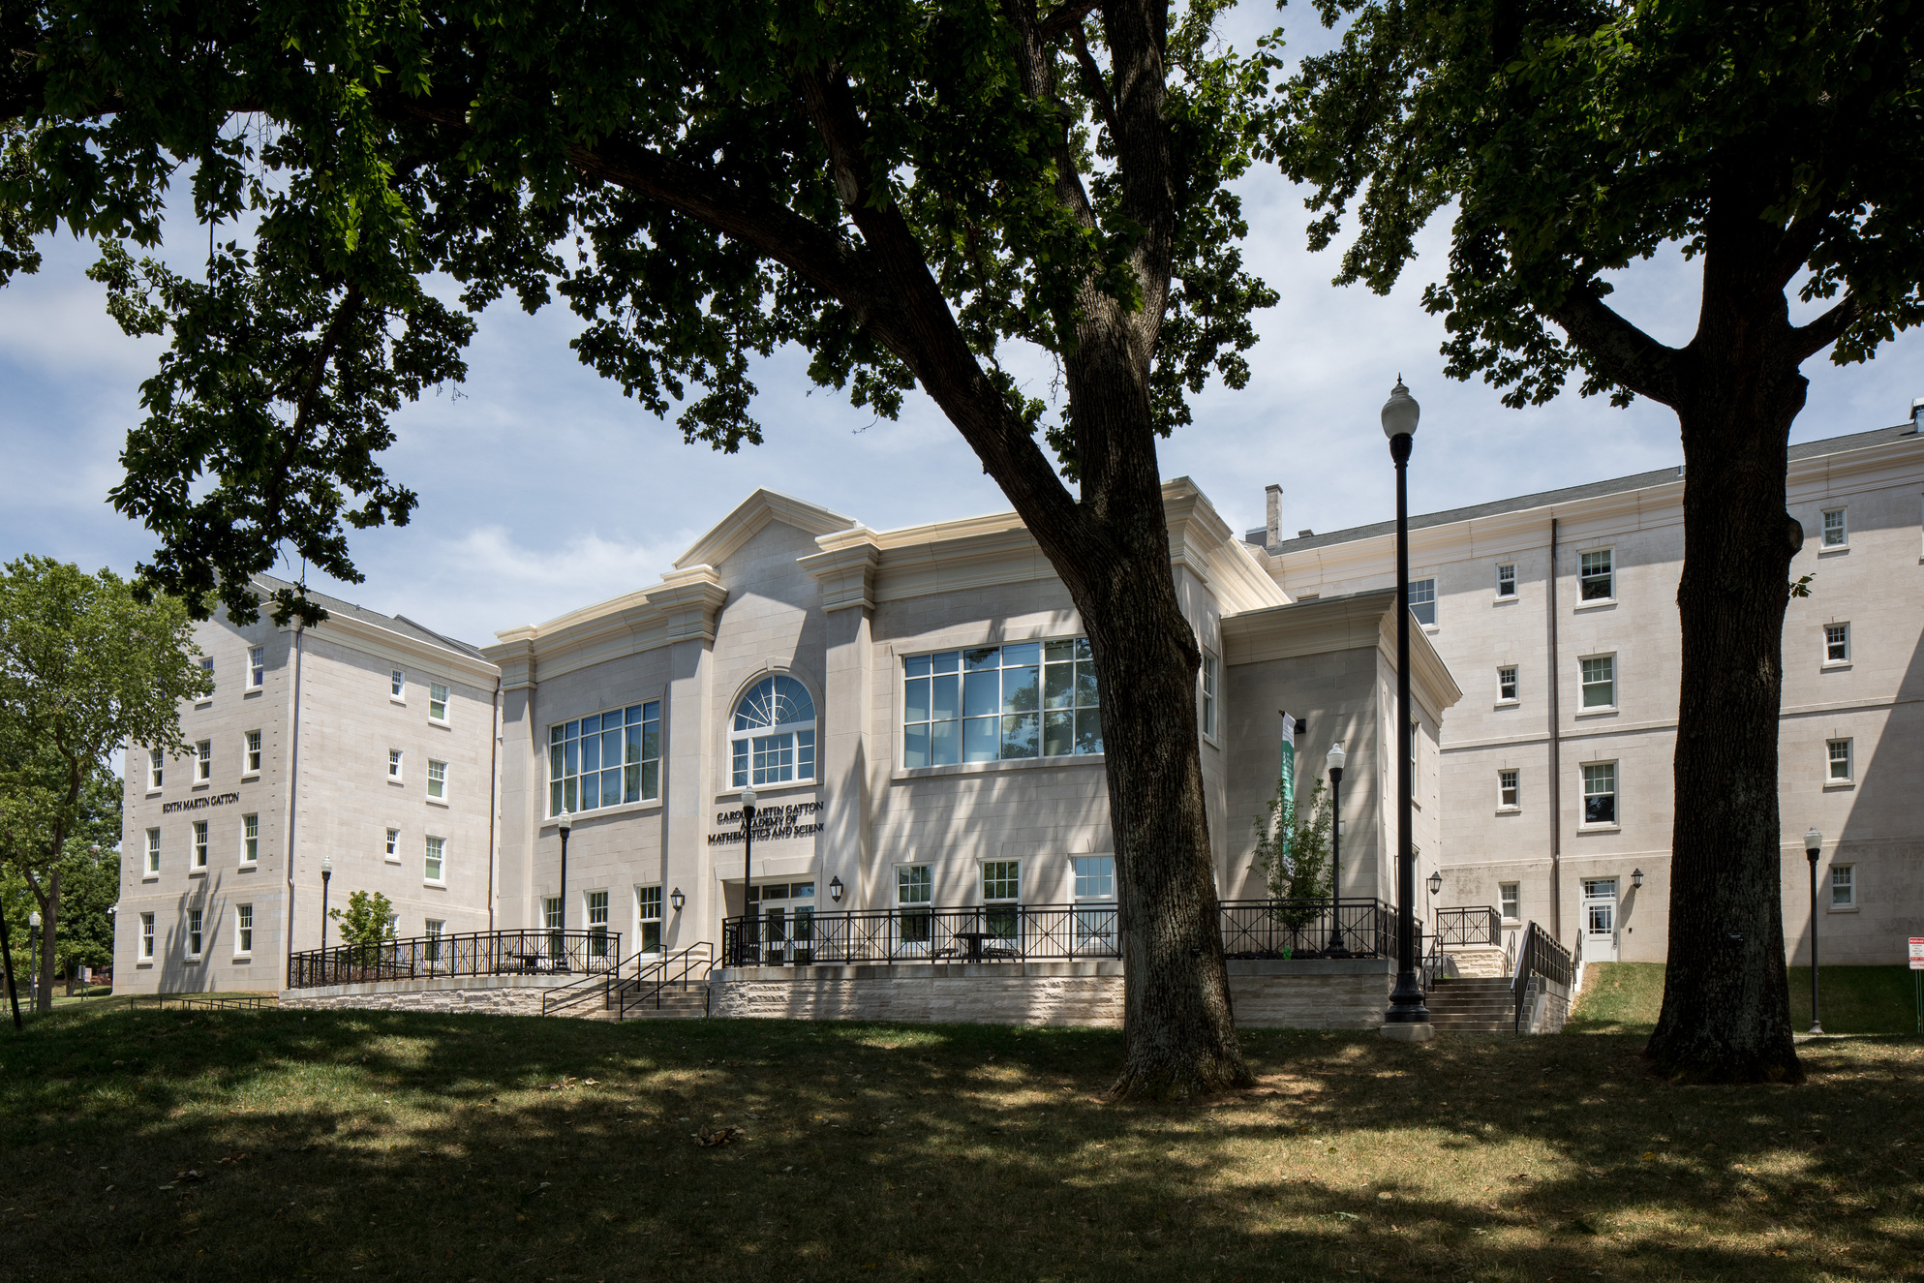
WHO?
Residential
STEM program
for gifted and talented
juniors and seniors in
Kentucky at WKU for 60 hours college credit at little to no cost.
WHAT?
WHEN?
Research
Languages
Student Life
Study Abroad
College Courses
All school-year -
Live at Gatton with
190 other Kentucky high
school students interested
in exploring new things.

Slide 6
